Slide 1
Swimming Pool Electrical Safety
June 2016

Slide 2
Course Outline
Current issues/status of code amendments
Summary of relevant FBC and NEC codes and standards (UL)
Overview of proper ground and luminaire bonding, GFCIs, stray voltage
Review of proper maintenance/servicing, repair and retrofitting

Slide 3
Current issues/ status of code amendments
Electrical systems are not generally well understood
Code compliance (inspections) relies on visual inspection—lack consistency
Poor and/or incorrect installation or maintenance
Environments are conducive to corrosion and damage
issues don’t stop with owner acceptance of the initial installation of the product or the end of the maintenance or service call

Slide 4
Relevant Codes and Standards: FBC
5th Edition FBC - Residential: Chapter 42 & 45
“Swimming pool” means any structure, located in a residential area, that is intended for swimming or recreational bathing and contains water over 24 inches deep, including, but not limited to, in-ground, aboveground, and on-ground swimming pools; hot tubs; and nonportable spas.

Slide 5
Relevant Codes and Standards: FBC
5th Edition FBC - Building: Section 454
Public swimming pool or public pool means a watertight structure of concrete, masonry, or other approved materials which is located either indoors or outdoors, used for bathing or swimming by humans, and filled with a filtered and disinfected water supply, together with buildings, appurtenances, and equipment used in connection therewith.

Slide 6
Relevant Codes and Standards: FBC
5th Edition FBC - Building: Section 454 (cont’d)
A public swimming pool or public pool shall mean a conventional pool, spa-type pool, wading pool, special purpose pool, or water recreation attraction, to which admission may be gained with or without payment of a fee and includes, but is not limited to, pools operated by or serving camps, churches, cities, counties, day care centers, group home facilities for eight or more clients, health spas, institutions, parks, state agencies, schools, subdivisions, or the cooperative living-type projects of five or more living units, such as apartments, boardinghouses, hotels, mobile home parks, motels, recreational vehicle parks, and townhouses. The term does not include a swimming pool located on the grounds of a private residence.

Slide 7
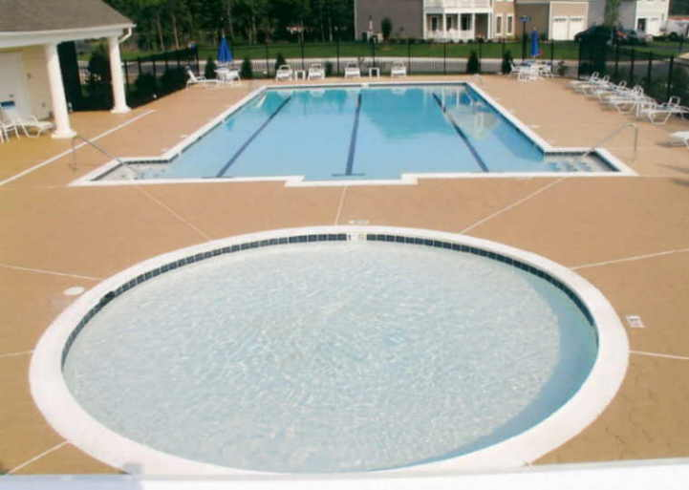

Slide 8
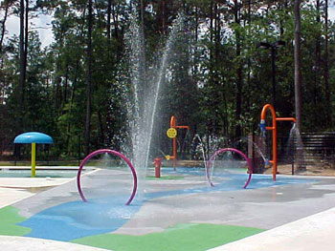

Slide 9
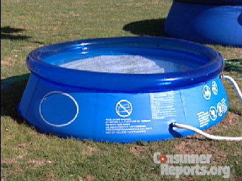

Slide 10
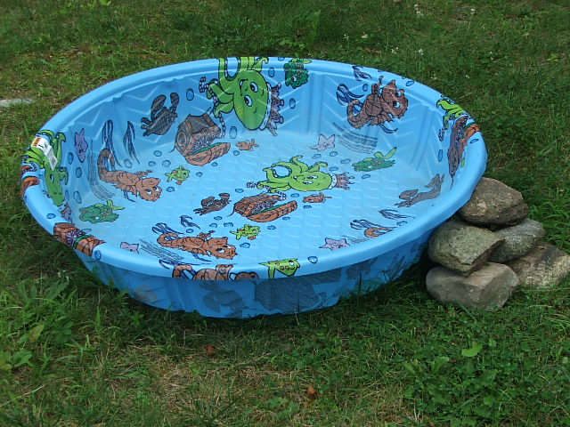

Slide 11
Relevant Codes and Standards: FBC
Florida Building Code–Building Chapter 4
454.2.7.2 / R01.7.2 – Pumps shall be installed in accordance with the manufacturer’s recommendations. (M1307 FBC-R / 301.12 FBC-M)
454.2.16 / R01.16 – Electrical wiring and equipment shall comply with Chapter 27 of the FBC (2008 / 2011 NEC).

Slide 12
Relevant Codes and Standards: FBC
Florida Building Code–Building Chapter 4 (cont’d)
454.2.19 / R01.19 – Final Inspection - Final electrical and barrier code inspection shall be completed prior to filling the pool with water.
Exception: Vinyl liner and fiberglass pools are required to be filled with water upon installation

Slide 13
Relevant Codes and Standards: FBC
Florida Building Code–Building Chapter 4
454.1.4 – Electrical Systems
.1.4.1 – Wiring and equipment must comply with the NEC.
.1.4.2 – Artificial lighting required for all pools to be used at night.

Slide 14
Relevant Codes and Standards: FBC
Florida Building Code–Building Chapter 4
454.1.4 – Electrical Systems (cont’d)
.4.2.1– Outdoor pools:
3 feet at the pool water surface = 3 footcandles
Underwater = ½ watt per square foot
.4.2.2 – Indoor pools:
3 feet at the pool water surface = 10 footcandles
Underwater = 8/10 watt per square foot
.4.2.3 – Underwater lighting:
15 volts max. / 300 watts max.
Exempt when 15 footcandles is provided overhead.

Slide 15
Relevant Standards: NEC – Article 680
2011 National Electric Code (NEC) Article 680 - Swimming Pools, Fountains, & Similar Installations:
General *
Permanently Installed Pools *
Storable Pools
Spas and Hot Tubs
Fountains
Pools and Tubs for Therapeutic Use
Hydromassage Bathtubs

Slide 16
Relevant Standards: NEC – Article 680
Section 680.2 - 23 total definitions (be familiar)
Article 100 Definitions also apply
LOW VOLTAGE CONTACT LIMIT - A voltage not exceeding:
15 volts (RMS) for sinusoidal AC
21.2 volts peak for nonsinusoidal AC
30 volts for continuous DC
12.4 volts peak for DC that is interrupted at a rate of 10 to 200 Hz
Permanent: > 42 in. or all indoor pools
Storable: < 42 in. or all pools nonmetallic, molded polymeric walls or inflatable fabric walls

Slide 17
Relevant Standards: NEC – Article 680
680.10 Underground Wiring Location
Shall not be permitted under the pool or within the area extending 5 ft. horizontally from the inside wall of the pool.

Slide 18
Relevant Standards: NEC – Article 680
680.12 Maintenance Disconnecting Means
One or more means to simultaneously disconnect all ungrounded conductors shall be provided for all utilization equipment other than lighting. Each means shall be readily accessible and within sight from its equipment and shall be located at least 5 ft. horizontally from the inside walls of a pool, spa, or hot tub unless separated from the open water by a permanently installed barrier that provides a 5 ft. reach path or greater. This horizontal distance is to be measured from the water’s edge along the shortest path required to reach the disconnect.

Slide 19
Relevant Standards: NEC – Article 680
II. Permanently Installed Pools
680.21 – Motors
680.22 – Lighting, Receptacles, & Equipment *
680.23 – Underwater Lighting *
680.24 – Junction Boxes & Electrical Enclosures *
680.25 – Feeders
680.26 – Equipotential Bonding *
680.27 – Specialized Pool Equipment

Slide 20
Relevant Standards: NEC – Article 680
680.21 Motors
(A)(1) – Any wiring method employed shall contain an insulated copper equipment grounding conductor.
(A)(4) – Cable assemblies are permitted where located in the interior of a one-family dwelling.
(A)(5) – Flexible cords shall not exceed 3 ft. for cord-and-plug connected pool motors.

Slide 21
Relevant Standards: NEC – Article 680
680.21(C) GFCI Protection
Outlets supplying pool pump motors connected to single-phase, 120 volt through 240 volt branch circuits rated 15 or 20 amperes, 125 volt or 240 volt, single phase, whether by receptacle or by direct connection, shall be provided with GFCI protection for personnel.
***ANSI / UL 1081 – 52.5(4)&(7)***

Slide 22
Relevant Standards: NEC – Article 680
680.22 Lighting, Receptacles, and Equipment
Receptacles:
Directly related to circulation or sanitation systems shall be 10-feet from inside walls of pool or not less than 6-feet where:
Consists of a single receptacle
Employ a locking configuration
Are of the grounding type
Have GFCI protection
Other receptacles shall be not less than 6-feet from the inside walls of the pool.

Slide 23
Relevant Standards: NEC – Article 680
680.22 Lighting, Receptacles, and Equipment (cont’d)
Receptacles:
Dwelling Units - No fewer than (1) 125-volt, 15- or 20-ampere receptacle shall be located not less than 6-feet from, and not more than 20-feet from, the inside wall of the pool and not greater than 6-feet, 6-inches above the floor / deck / grade level.
All 15- and 20-ampere, 125-volt receptacles located within 20-feet of the inside wall of the pool shall be GFCI protected.

Slide 24
Relevant Standards: NEC – Article 680
680.22 Lighting, Receptacles, and Equipment (cont’d)
Luminaires, Lighting Outlets, & Ceiling-Suspended (Paddle) Fans:
New Outdoor: 12-foot minimum height above water level, extending 5-feet horizontally from inside walls of pool
Indoor: Same as (1) OR can be reduced to 7 ft. 6 in. when GFCI protected
Existing: 5-foot minimum height above water level, extending 5-feet horizontally from inside walls of pool, GFCI protected

Slide 25
Relevant Standards: NEC – Article 680
680.22 Lighting, Receptacles, and Equipment (cont’d)
Switching Devices:
shall be located not less than 5-feet horizontally from the inside walls of the pool
Other Outlets:
shall be located not less than 10-feet from the inside walls of the pool

Slide 26
Relevant Standards: NEC – Article 680
680.23 – Underwater Luminaires
General ( Installation Instructions / Listing Req. / UL 676 )
Wet-Niche Luminaires (completely surrounded by water)
Dry-Niche Luminaires (sealed against entry of water)
No-Niche Luminaires (without a niche)
Through-Wall Lighting Assembly

Slide 27
Wet-Niche Luminaire

Slide 28
Dry-Niche Luminaire

Slide 29
No-Niche Luminaire

Slide 30
Through-Wall Lighting Assembly

Slide 31
Relevant Standards: NEC – Article 680
680.23(B)(2)(b) Wiring Extending Directly to the Forming Shell
#8 AWG insulated solid or stranded copper bonding jumper.
The termination at the forming shell shall be covered with a listed potting compound.
UL 676A / WCRY

Slide 32
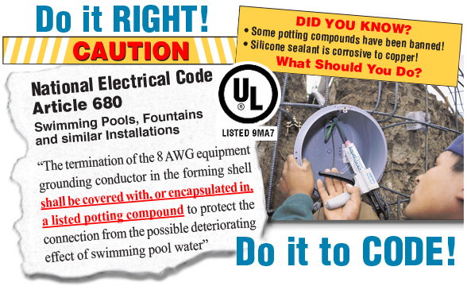
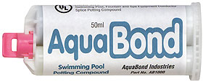

Slide 33
Relevant Standards: NEC – Article 680
680.23(B)(6) Servicing
All wet-niche luminaires shall be removable from the water for inspection, relamping, or other maintenance The forming shell location and length of cord in the forming shell shall permit personnel to place the removed luminaire on the deck or other dry location for such maintenance. The luminaire maintenance location shall be accessible without entering or going in the pool water.

Slide 34
Relevant FBC and NEC codes and standards (UL)
680.23(F)(2) Equipment Grounding.
Through-wall lighting assemblies, wet-niche, dry-niche, or no-niche luminaires shall be connected to an insulated copper equipment grounding conductor installed with the circuit conductors. The equipment grounding conductor shall be installed without joint or splice except as permitted in (F)(2)(a) and (F)(2)(b). The equipment grounding conductor shall be sized in accordance with Table 250.122 but shall not be smaller than 12 AWG.

Slide 35
Relevant Standards: NEC – Article 680
680.24 Junction Boxes, Transformer, GFCI Enclosure
Junction Boxes – UL 1241 / WCEZ
Other Enclosures
Protection
Grounding Terminals
Strain Relief
Grounding

Slide 36
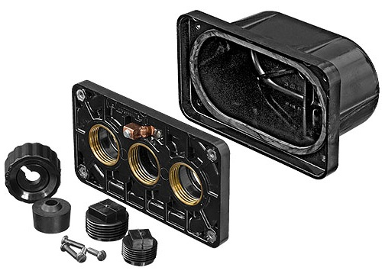
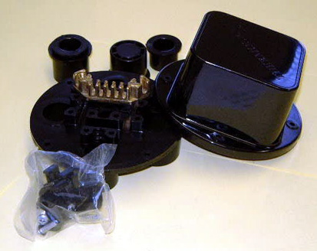
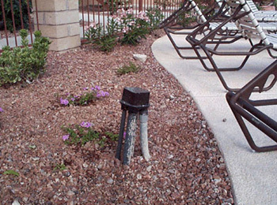
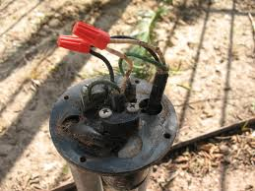

Slide 37
Relevant Standards: NEC – Article 680
680.24(A)(1) Construction.
The junction box shall be listed as a swimming pool junction box and shall comply with the following conditions:
Be equipped with threaded entries or hubs or a nonmetallic hub
Be comprised of copper, brass, suitable plastic, or other approved corrosion-resistant material
Be provided with electrical continuity between every connected metal conduit and the grounding terminals by means of copper, brass, or other approved corrosion-resistant metal that is integral with the box

Slide 38
Relevant Standards: NEC – Article 680
680.24(A)(2) Installation.
Where the luminaire operates over the low voltage contact limit, the junction box location shall comply with (A)(2)(a) and (A)(2)(b). Where the luminaire operates at the low voltage contact limit or less, the junction box location shall be permitted to comply with (A)(2)(c).

Slide 39
Relevant Standards: NEC – Article 680
680.24(A)(2) Installation. (cont’d)
Vertical Spacing. The junction box shall be located not less than (4 in.), measured from the inside of the bottom of the box, above the ground level, or pool deck, or not less than (8 in.) above the maximum pool water level, whichever provides the greater elevation.
Horizontal Spacing. The junction box shall be located not less than (4 ft.) from the inside wall of the pool, unless separated from the pool by a solid fence, wall, or other permanent barrier.

Slide 40
Relevant Standards: NEC – Article 680
680.24(A)(2) Installation. (cont’d)
Flush Deck Box. If used on a lighting system operating at the low voltage contact limit or less, a flush deck box shall be permitted if both of the following conditions are met:
An approved potting compound is used to fill the box to prevent the entrance of moisture.
The flush deck box is located not less than (4 ft) from the inside wall of the pool.

Slide 41
Relevant Standards: NEC – Article 680
680.24(E) Strain Relief. The termination of a flexible cord of an underwater luminaire within a junction box, transformer or power-supply enclosure, ground-fault circuit interrupter, or other enclosure shall be provided with a strain relief.

Slide 42
Relevant Standards: NEC – Article 680
680.25 Feeders. These provisions shall apply to any feeder on the supply side of panelboards supplying branch circuits for pool equipment covered in Part II of this article and on the load side of the service equipment or the source of a separately derived system.

Slide 43
Relevant Standards: NEC – Article 680
680.25 Feeders (cont’d)
Wiring Methods
Feeders shall be installed in RMC or IMC or one of the other (6) methods.
Exception: An existing feeder between an existing remote panelboard and service equipment shall be permitted to run in flexible metal conduit or an approved cable assembly that includes an equipment grounding conductor within its outer sheath.
Grounding
Shall be insulated.

Slide 44
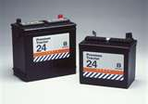
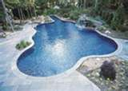
Relevant Standards: NEC – Article 680
680.26 - Equipotential Bonding
Performance. The equipotential bonding required by this section shall be installed to reduce voltage gradients in the pool area.

Slide 45
Relevant Standards: NEC – Article 680
680.26(B) Bonded Parts
Conductive Pool Shell
Perimeter Surfaces
Metallic Components
Underwater Lighting
Metal Fittings
Electrical Equipment
Fixed Metal Parts

Slide 46
Relevant Standards: NEC – Article 680
680.26(B) Bonded Parts.
The parts specified in 680.26(B)(1) through (B)(7) shall be bonded together using solid copper conductors, insulated covered, or bare, not smaller than 8 AWG or with rigid metal conduit of brass or other identified corrosion-resistant metal. Connections to bonded parts shall be made in accordance with 250.8. An 8 AWG or larger solid copper bonding conductor provided to reduce voltage gradients in the pool area shall not be required to be extended or attached to remote panelboards, service equipment, or electrodes.

Slide 47
Relevant Standards: NEC – Article 680
680.26(B) Bonded Parts (cont’d)
Perimeter Surfaces
The perimeter surface shall extend for (3 ft) horizontally beyond the inside walls of the pool & shall include unpaved surfaces, as well as poured concrete surfaces & other types of paving. Bonding to perimeter surfaces shall be provided as specified in 680.26(B)(2)(a) or (2)(b) and shall be attached to the pool reinforcing steel or copper conductor grid at a minimum of four (4) points uniformly spaced around the perimeter of the pool.

Slide 49
Relevant Standards: NEC – Article 680
680.26(B) Bonded Parts (cont’d)
Metallic Components. All metallic parts of the pool structure, including reinforcing metal not addressed in 680.26(B)(1)(a), shall be bonded. Where reinforcing steel is encapsulated with a nonconductive compound, the reinforcing steel shall not be required to be bonded.

Slide 50
Relevant Standards: NEC – Article 680
680.26(B) Bonded Parts (cont’d)
Underwater Lighting. All metal forming shells and mounting brackets of no-niche luminaires shall be bonded.
Exception: Listed low-voltage lighting systems with nonmetallic forming shells shall not require bonding.

Slide 51
Relevant Standards: NEC – Article 680
680.26(B) Bonded Parts (cont’d)
Metal Fittings. All metal fittings within or attached to the pool structure shall be bonded. Isolated parts that are not over (4 in.) in any dimension and do not penetrate into the pool structure more than (1 in.) shall not require bonding.

Slide 52
Relevant Standards: NEC – Article 680
680.26(B) Bonded Parts (cont’d)
Electrical Equipment. Metal parts of electrical equipment associated with the pool water circulating system, including pump motors and metal parts of equipment associated with pool covers, including electric motors, shall be bonded.
Exception: Metal parts of listed equipment incorporating an approved system of double insulation shall not be bonded.
Fixed Metal Parts. All fixed metal parts shall be bonded.

Slide 54
Relevant Standards: NEC – Article 680
680.26(C) Pool Water.
An intentional bond of a minimum conductive surface area of (9-square inches) shall be installed in contact with the pool water. This bond shall be permitted to consist of parts that are required to be bonded in 680.26(B).

Slide 55
Relevant Standards: NEC – Article 680
680.27 Specialized Pool Equipment
Underwater Audio Equipment – UL 1480 / UEAY
Speakers
Wiring Methods
Forming Shell & Metal Screen.

Slide 56
Relevant Standards: NEC – Article 680
680.27 Specialized Pool Equipment (cont’d)
(B) Electrically Operated Pool Covers – UL 1081 / WDDJ
Motors & Controllers
Protection
Deck Area Heating
Unit Heaters
Permanently Wired Radiant Heaters
Radiant Heater Cables Not Permitted.

Slide 57
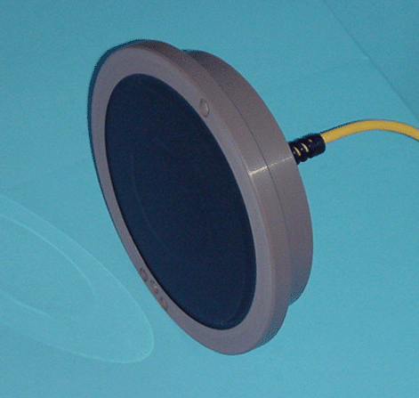

Slide 58
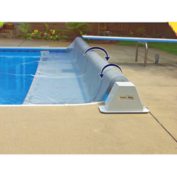

Slide 59
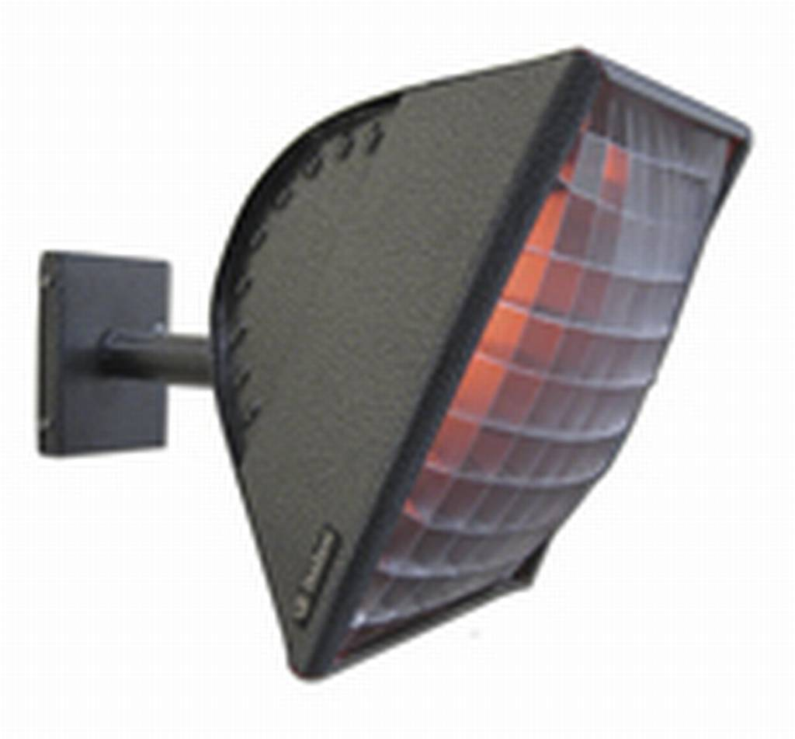

Slide 60
Relevant Standards: NEC – Article 680
Storable Pools
Storable Swimming, Wading, or Immersion Pool - those that constructed on/above the ground and are capable of holding water to a maximum depth of 42 in., or a pool with nonmetallic, molded polymeric walls or inflatable walls regardless of dimension.
680.30 – General
680.31 – Pumps
680.32 – Ground-Fault Circuit Interrupters Required
680.33 – Luminaires
680.34 – Receptacle Locations

Slide 61
Relevant FBC and NEC codes and standards (UL)
Pumps / GFCI Protection
Storable Pools shall comply with Part I & III of Article 680
680.31 Pumps
Cord-connected pool filter pumps shall be provided with a GFCI that is integral to the cord or attachment plug.
680.32 GFCI Protection Required
All electrical equipment for the storable pool & 125-volt, 15- and 20-ampere receptacles within 20 ft of the storable pool shall be protected by a GFCI.

Slide 62
Relevant Standards: NEC – Article 680
680.33 Luminaires
Within the Low Voltage Limit Contact
Luminaires shall be a LISTED cord-and-plug connected lighting assembly that complies with Part II of Article 680 and located in or on the wall of the pool.
Over the Low Voltage Contact Limit But Not over 150 Volts
Shall be a LISTED cord-and-plug connected lightning assembly that complies with 680.23(A)(5) and located in or on the wall of the pool.

Slide 63
Relevant Standards: NEC – Article 680
680.34 Receptacle Locations
Receptacles shall not be located less than (6 ft) from the inside walls of a pool. In determining these dimensions, the distance to be measured shall be the shortest path the supply cord of an appliance connected to the receptacle would follow without piercing a floor, wall, ceiling, doorway with hinged or sliding door, window opening, or other effective permanent barrier.

Slide 64
Relevant Standards: NEC – Article 680
Spas & Hot Tubs
680.40 General – UL 1563 / WBYQ / WCZW
680.41 Emergency Switch for Spas & Hot Tubs
680.42 – Outdoor Installations*
680.43 – Indoor Installation*
680.44 - Protection

Slide 65
Relevant Standards: NEC – Article 680
680.42 Outdoor Installations
Shall comply with Part I & II of the Article
Flexible Conduit – 6 ft maximum (external to the spa)
Cord-&-Plug Connection – 15 ft maximum
Cable assemblies are permitted where located in the interior of a one-family dwelling

Slide 66
Relevant Standards: NEC – Article 680
TIA 11-1 – 680.42(B) Bonding
Exception No. 1 – The metal bands or hoops used to secure wooden staves shall not be required to be bonded.
Exception No. 2 – The top rim of the spa is (28 in.) above the perimeter surfaces within (30 in.) of the spa.

Slide 67
Relevant Standards: NEC – Article 680
680.43 Indoor Installations
Receptacles – Location & Protection
Luminaires / Fans – Elevation Requirements
Switches – Location
Bonding – (5) parts
Methods of Bonding – (3) methods
Grounding – (2) requirements
Underwater Audio Equipment – Part II
Exception No. 2. The equipotential bonding requirements for perimeter surfaces in 680.26(B)(2) shall not apply to a listed self-contained spa or hot tub installed above a finished floor.

Slide 68
Relevant Standards: NEC – Article 680
Fountains
680.50 General
680.51 Luminaires, Submersible Pumps, & Other Submersible Equipment*
680.52 Junction Boxes & Other Enclosures
680.53 Bonding*
680.54 Grounding*
680.55 Methods of Grounding
680.56 Cord-and-Plug Connected Equipment
680.57 Signs
680.68 GFCI Protection for Adjacent Receptacle Outlets

Slide 69
Relevant Standards: NEC – Article 680
680.50 General
Shall comply with Part I of the Article
Fountains with water common to a pool shall comply with Part II of the Article
Portable fountains shall comply with Parts II & III of Article 422

Slide 70
Relevant Standards: NEC – Article 680
680.51 Equipment
GFCI Protection requirements
Operating Voltage limitations
Luminaire Lenses requirements
Overheating Protection requirements
Wiring method requirements
Servicing of equipment
Stability of equipment / fastening

Slide 71
Relevant Standards: NEC – Article 680
680.53 Bonding.
All metal piping systems associated with the fountain shall be bonded to the equipment grounding conductor of the branch circuit supplying the fountain.

Slide 72
Relevant Standards: NEC – Article 680
680.54 Grounding.
The following equipment shall be grounded:
All electrical equipment located within the fountain or within (5 ft) of the inside wall of the fountain
All electrical equipment associated with the recirculating system of the fountain
Panelboards that are not part of the service equipment and that supply any electrical equipment associated with the fountain

Slide 73
Relevant Standards: NEC – Article 680
Pools & Tanks for Therapeutic Use
680.60 – General
680.61 – Permanently Installed Therapeutic Pools
680.62 – Therapeutic Tubs / Tanks

Slide 74
Relevant Standards: NEC – Article 680
Tubs & Tanks
Shall be GFCI protected.
All metal parts & equipment of the tub or tank & any metal surfaces, metal wiring methods, & metal equipment shall be BONDED together per Part (C) 1, 2, 3, or 4.
All receptacles within 6 ft. of the tub or tank shall be protected with a GFCI.
Luminaires shall be of the totally enclosed type.

Slide 75
Relevant Standards: NEC – Article 680
Hydromassage Bathtubs - A permanently installed bathtub equipped with a recirculating piping system, pump, and associated equipment. It is designed so it can accept, circulate, and discharge water upon each use.
680.70 – General
680.71 – Protection
680.72 – Other Electrical Equipment
680.73 – Accessibility
680.74 – Bonding

Slide 76
Relevant Standards: NEC – Article 680
680.71 Protection
Individual branch circuit required
Readily accessible GFCI protection
680.73 Accessibility
The bathtub’s electrical equipment shall be accessible without damaging the building structure or building finish.
The receptacle shall be installed within (1 ft) of the opening.

Slide 77
Relevant Standards: NEC – Article 680
680.74 Bonding
All metal piping systems and all grounded metal parts in contact with the circulating water shall be bonded together using a solid copper bonding jumper, insulated, covered, or bare, not smaller than 8 AWG.
The bonding jumper shall be connected to the terminal on the circulating pump motor that is intended for this purpose.

Slide 78
Relevant Standards: NEC – Article 680
680.74 Bonding (cont’d)
The bonding jumper shall not be required to be connected to a double insulated circulating pump motor.
The 8 AWG or larger solid copper bonding jumper shall be required for equipotential bonding in the area of the hydromassage bathtub and shall not be required to be extended or attached to any remote panelboard, service equipment, or any electrode.

Slide 80
Ground and luminaire bonding, GFCIs, stray voltage
Article 100 of the National Electrical Code defines bonding as connected to establish electrical continuity and conductivity. This is different from grounding, which is defined as connecting to ground or to a conductive body that extends the ground connection.

Slide 81
Ground and luminaire bonding, GFCIs, stray voltage
It is possible to accomplish equipotential bonding without providing grounding. Although some equipment in NEC 680.26 might ultimately be connected to ground, equipotential bonding is accomplished by bonding conductive components within reach of the pool.

Slide 82
Ground and luminaire bonding, GFCIs, stray voltage
Bonding vs. grounding
To reduce confusion, the NEC now more correctly refers to equipotential bonding
Equipotential surface voltages between all points in or out of the water are approximately equal.
Bonding is required even without any electrical equipment

Slide 83
Ground and luminaire bonding, GFCIs, stray voltage
A properly-installed equipotential bonding system can divert current to earth through the pool/deck structure and not through the water.
The earth cannot and must not be used as a grounding conductor.

Slide 84
Ground and luminaire bonding, GFCIs, stray voltage
An equipment ground wire is not the same as a bond wire; grounding to the electrical systems ground bus cannot be used in lieu of proper bonding, even when both are call for.

Slide 85
Ground and luminaire bonding, GFCIs, stray voltage
The pool structure includes the deck and coping!
Fixed metal parts with 5 feet of the pool must be bonded.
All metal fittings within or attached to the pool structure greater than 4" in any dimension and penetrating into the structure more than 1" must be bonded!

Slide 86
Ground and luminaire bonding, GFCIs, stray voltage
Double-insulated pump motors
Must have a #8 AWG solid copper bonding wire run from pool to an accessible point in pump area
Motors with a grounding screw must connect to equipment ground conductor of motor circuit at the motor
If bonding grid is not grounded, you must connect it to equipment grounding conductor of motor circuit at the motor.

Slide 87
Ground and luminaire bonding, GFCIs, stray voltage
Coated/encapsulated rebar cannot serve as a bonding grid to create the equipotential surface.
Copper wire grid connections must be per 250.8 or other approved means and must be connected to the bonding system:
Exothermic welding (cadwelding)
Listed pressure connectors
Listed clamps
Other listed means – may include a copper wire grid under or in a conductive pool shell.

Slide 88
Ground and luminaire bonding, GFCIs, stray voltage
Intentional bonding connection to the water only required when none of the bonded parts are in direct connection with the pool water
Minimum 9 sq. in. in contact with the water (e.g., 3" × 3" plate) at all times
Must be corrosion-resistant
Must be located where it is not exposed to physical damage or dislodgement during usual pool activities]
Must be connected to the equipotential bonding grid

Slide 89
Maintenance/servicing/repair
Light fixture repairs can affect bonding
Electrical bonding between the light and niche occurs at the attachment screw. This is the only reliable connection between the light and niche!
While an electrical connection between the hooks on the light fixture and the niche can exist for a while after installation, it is not reliable!

Slide 90
Maintenance/servicing/repair
Light fixture repairs (cont’d)
Installing after-market repair parts such as float-in rings and plastic light fixture clamping devices can destroy the electrical safety connection between the light fixture and the bonded niche!

Slide 91
Maintenance/servicing/repair
Bonding light to broken niche or plaster ring
For situations where light cannot bond to niche, or no niche exists (plaster ring only).
Add #12 solid copper green bonding wire in niche.
Connect wire to light ring using lugs and split bolts. Make sure screws are brass or stainless steel.

Slide 92
Maintenance/servicing/repair
Bonding light (cont’d)
Tape or cable tie wire to light cored and bond to niche (if available) or J-box.
Make sure screws are tight!
Use sealant such as Skotchkote™ (3M) on lugs and split bolts and pot any connection at rear of niche.

Slide 93
Maintenance/servicing/repair
Simple tests on existing pools
Visual inspection
Bonding test
Grounding test
GFCI test

Slide 94
Resources
Associations representing manufacturers, builders, designers, distributors, suppliers, installers, retailers, service technicians and inspectors:
International Association of Electrical Inspectors (IAEI): www.iaei.org/web/Online
National Electrical Manufacturers Association (NEMA): www.nema.org/pages/default.aspx
Association of Pool & Spa Professionals (APSP): www.apsp.org
Florida Swimming Pool Association (FSPA): www.floridapoolpro.com
United Pool & Spa Association (UPSA): www.upsaonline.com

Slide 95
Acknowledgments
A special thank you to the Association of Pool & Spa Professionals (APSP), the Florida Swimming Pool Association (FSPA), and National Electrical Manufacturers Association (NEMA), the National Fire Protection Association (NFPA) and Hamilton & Associates.
This presentation was created under direction from the joint Swimming Pool and Electrical Technical Advisory Committees of the Florida Building Commission with funding from the Department of Building and Professional Regulation.

